Slide 1
Department of Electronics Engineering ,AMU
Problem Presentation of UG Project
Project Title : Algorithm for Object Palletizing using Robotic Arm
Team Members :
Maha Zakir khan 19ELB056 GL3136
Shaista Tabrez 19ELB057 GL3139
Project Type: New, no prior work carried out.
Date of presentation : 14-12-22

Slide 2
Oath
"I affirm that I will not copy the project work and shall be completing all tasks without any unethical help, and all work in this project will be my own."

Slide 3
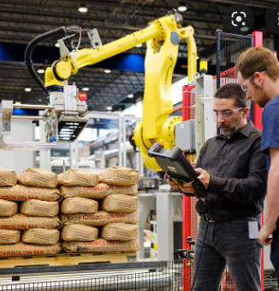
Problem Statement
Palletizing refers to the task of arranging similar objects like a carton or a sack and arranging it in a defined pattern.
We are investigating methods to optimize the palletizing task using collision-free trajectory planning algorithm (PSO) for domestic applications

Slide 4
Abstract
Industries are witnessing a rapid rise in the use of robots for automation task, however robots at home or robots at the workplace assisting humans side by side in day to day tasks is still seen as a thing of the future.
We plan on devising a way to introduce robot in non-industrial settings helping people in common everyday problems like sorting and stacking disorganized objects in homes, kids playrooms or workplaces.

Slide 5
Objectives
Build and test simulation model for kinematic analysis
To explore Trajectory Planning Algorithm
PSO (Particle Swarm Optimization)
Optimize the algorithm for palletizing task and test it on the simulation model.
Detecting and tracking position of objects to be sorted and stacked (small cubes/cuboids in our case)
Picking up, carrying and placing objects using the simulation model.
Deployment on hardware and testing in a structured environment.

Slide 6

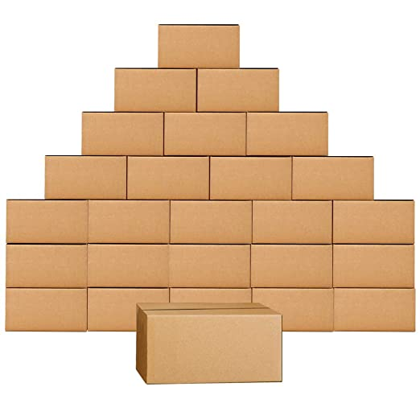
Deliverables
Propose to develop a prototype to test the optimized algorithm by picking and placing small identical sized cardboard models

Slide 7
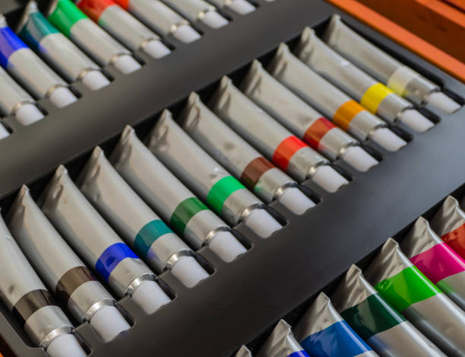
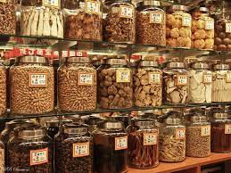

Beneficiaries
Medicine jars organizer for arthritis patients
Desk organizer for painters
Kitchen assistant:
Managing spice jars
Stacking washed dishes into racks
Stacking and sorting fruits into fruit piles

Slide 8
Literature Review
In Optimal Trajectory Planning for a Robotic Manipulator Palletizing Tasks the problem of palletizing objects from a pre-determined storage area to a delivery area is discussed. The aim is finding the sequence of the moves of the manipulator that minimizes the length of the travelled path. The optimal solution is obtained by formalizing the palletizing task problem in an Integer Linear Programming (ILP) problem.
Our aim is to expand the research further by:
1. Palletizing objects from a non -predetermined storage area
2. Generalizing the movements by collision-free trajectory planning
In Trajectory Optimization With Particle Swarm Optimization for Manipulator Motion Planning trajectory optimization using particle swarm optimization (PSO) is investigated. The proposed algorithm successfully optimized a trajectory while satisfying the constraints and is less likely to converge to a local minimum.

Slide 9
Technical Readiness Level
TRL 1 will be achieved in this project:​
Basic concepts explored, observed and reported​
TRL 9
System ready for full scale development
TRL 8
System Interpolated
TRL 7
Integrated Plot System Demonstration
TRL 6
Prototype system verified
TRL 5
Laboratory Testing of Interated System
TRL 4
Laboratory Testing of prototype concept
TRL 3
Proof of concept
TRL 2
Technology Formulated
TRL 1
Basic Research

Slide 10
Timeline
Pose estimation
Testing ,pick, move and place operations in simulation
Object Detection and Tracking using Mediapipe
Finalizing the topic
Finalizing results and report submission
Start of major project
September
November
December
March
End of major project
August
October
January February
April
Finalize major project Phase-I and report submission
Literature review of prior work
Implementation on manipulator and ESP32CamModule
Comparing and finalizing optimal solution

Slide 11
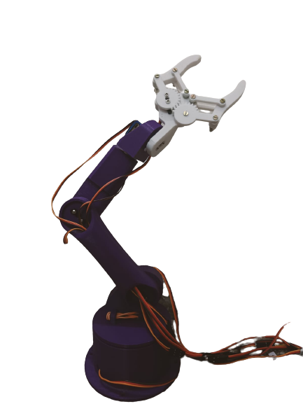
Hardware Requirements
Gripper / End Effector
Wrist
6 Degree Of Freedom Manipulator (available)
6 servos :3 MG966R, 3 MG90S (available)
Arduino UNO REV3 (available)
ESP32 Cam Module (available)
STM32 NucleoBoard (available at club)
Elbow
Arm
Base
11

Slide 12
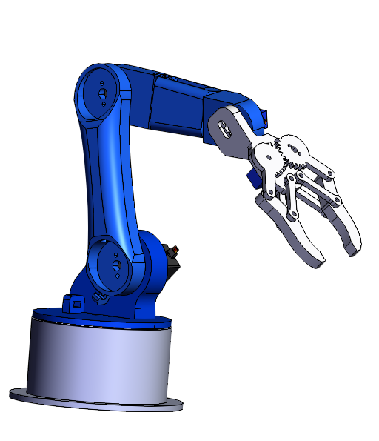
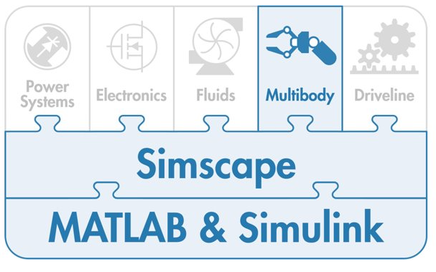
Software Platform Used
Platform:
MATLAB & Simulink and it's various tools*
SolidWorks*
*Available at Electronics department
*Available at Mechanical department

Slide 13
Workflow Diagram
Picking
Mediapipe
Object detection, pose estimation and tracking
Pose estimation of gripper
Kinematics Analysis
Joint Constraints
Workspace Calculations
Trajectory Planning
CAD Model
imported from *opensource
Trajectory Planning :
PSO
Simscape Multibody
Robotics system Toolbox
Optimized algorithm generation
Simulation Testing
Joint state variables
Forward Kinematics
&DH Conventions
Placing
Simulation Testing of planned motion
Estimating placement place
Estimating placement stack
*https://howtomechatronics.com/tutorials/arduino/diy-arduino-robot-arm-with-smartphone-control/

Slide 14
References
Liangjun Zhang, Y. J. Kim and Dinesh Manocha, "A hybrid approach for complete motion planning," 2007 IEEE/RSJ International Conference on Intelligent Robots and Systems, 2007, pp. 7-14, DOI: 10.1109/IROS.2007.4399064.
Gi Hyun Lim, Nuno Lau, Eurico Pedrosa, Filipe Amaral, Artur Pereira, José Luís Azevedo & Bernardo Cunha (2019) Precise and efficient pose estimation of stacked objects for mobile manipulation in industrial robotics challenges, Advanced Robotics, 33:13, 636-646, DOI: 10.1080/01691864.2019.1617780
Jiang, D., Li, G., Sun, Y. et al. Manipulator grabbing position detection with information fusion of color image and depth image using deep learning. J Ambient Intell Human Comput 12, 10809–10822 (2021). https://doi.org/10.1007/s12652-020-02843-w
Ahmadi, S. (2022). Real-time motion planning of 6 DOF Collaborative Robot (Dissertation). Retrieved from http://urn.kb.se/resolve?urn=urn:nbn:se:kth:diva-308528
Antti Hietanen, Jyrki Latokartano, Alessandro Foi, Roel Pieters, Ville Kyrki, Minna Lanz, Joni-Kristian Kämäräinen, "Benchmarking pose estimation for robot manipulation", Robotics and Autonomous Systems, Volume 143, 2021, 103810, ISSN 0921-8890, https://doi.org/10.1016/j.robot.2021.103810.
Rafal Szczepanski, Krystian Erwinski, Mateusz Tejer, Artur Bereit, Tomasz Tarczewski, ''Optimal scheduling for palletizing task using robotic arm'', Engineering Applications of Artificial Intelligence, Volume 113, 2022, 104976, ISSN 0952-1976, https://doi.org/10.1016/j.engappai.2022.104976.

Slide 15

Thank you !
We are open to further discussions and questions from your side.

Slide 16
Picking
Mediapipe
Object detection, pose estimation and tracking
Pose estimation of gripper
Kinematics Analysis
Joint Constraints
Workspace Calculations
Trajectory Planning
CAD Model
imported from *opensource
Simscape Multibody
Robotic system Toolbox
Trajectory Planning :
PSO
Optimized algorithm generation
Simulation and Testing
Joint state variables
Forward
Kinematics
&DH
Conventions
Placing
Simulation and testing of planned motion
Estimating Placement Place
Estimating Placement Stack

